Slide 1
FlatFinderSG
A50 Team One.Zero
Group Members:
BRYAN TAN SHAO XUAN
FAN YUPEI
GAY WEI HAO
GOH XIAN HAO GLENDON
JABEZ NG YONG XIN

Slide 2
01
Requirement Analysis & Design

Slide 3
Requirement Elicitation
Our Mission
Streamline the process of buying and selling home properties
Flat buyers
A one-stop platform for flat finding
Search by different factors
Integrated tools for grant calculating
Flat sellers
List property without much hassle
Viewing other housing properties for price reference
Notes:
FlatFinderSG is an improved version of current applications that allow the buying and selling of housing properties in Singapore. By providing a one-stop e-commerce platform, individuals seeking to buy or sell housing properties can easily add a listing to the platform or search for an ideal listing that they desire, thereby improving the overall process of buying and selling property listings. By leveraging a grant calculator feature and a compare price with resale flats feature, buyers will be able to easily gain access to crucial data to aid them in making a more informed decision. This will help tremendously in improving the overall user experience.

Slide 4
FlatFinderSG Functions
View Listings
Add Listings
Access and view all property listings.
View details
Add a property listing to the database easily
Compare Listings
Search
View the average price.
Compare the properties with same neighborhood and same number of rooms
Search for property listings based on address
Filter
Calculate Grants
Filter the displayed property listings by the number of bedrooms
View the number of grants
View the grant types eligible
View the property price after the grant deduction
Notes:
our product will fullfil the following basic functions:
view
search
filter
add new properties
[click] also the different functionalities of our application that make it stand out from the competition:
compare function
Grant calculation

Slide 5
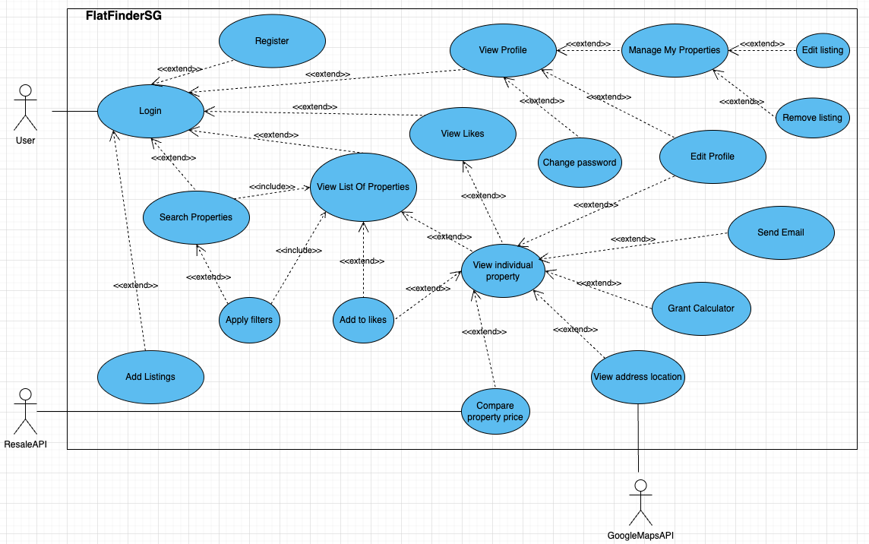
Use Case Diagram
Send Email
Grant Calculator
Compare Property Price

Slide 6
02
System Design

Slide 7
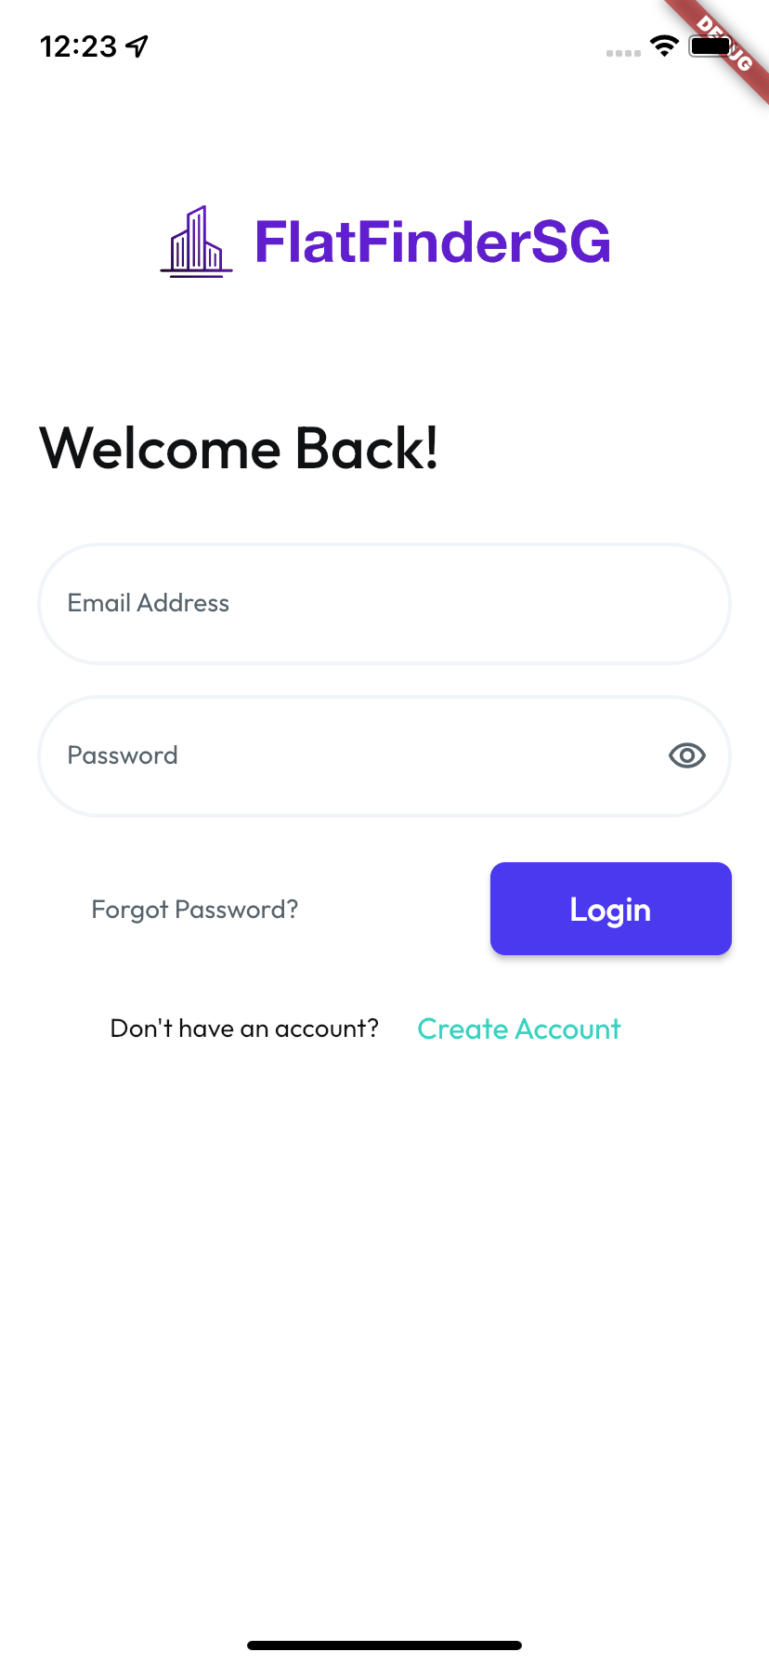





Application Development
Backend
External API
Firebase (NoSQL Database) (BaaS)
Cloud Firestore
Analytics: Firebase Analytics
Monitoring: Firebase Performance Monitoring
Firebase Storage
Firebase Authentication
Google Maps API
Data.Gov Resale Flat Prices API
EmailJS API
Geocoding API
Operating Platform
Development Platform: IOS XCode Simulator and Android Studio
For Android Studio: 32 recommended
Operating System Platform: IOS and Android
Frontend
Dart: Flutter
Flutter Version: 3.7.8
Dart Version: 2.19.5
Architecture: arm64
Notes:
BaaS is backend as a service

Slide 8
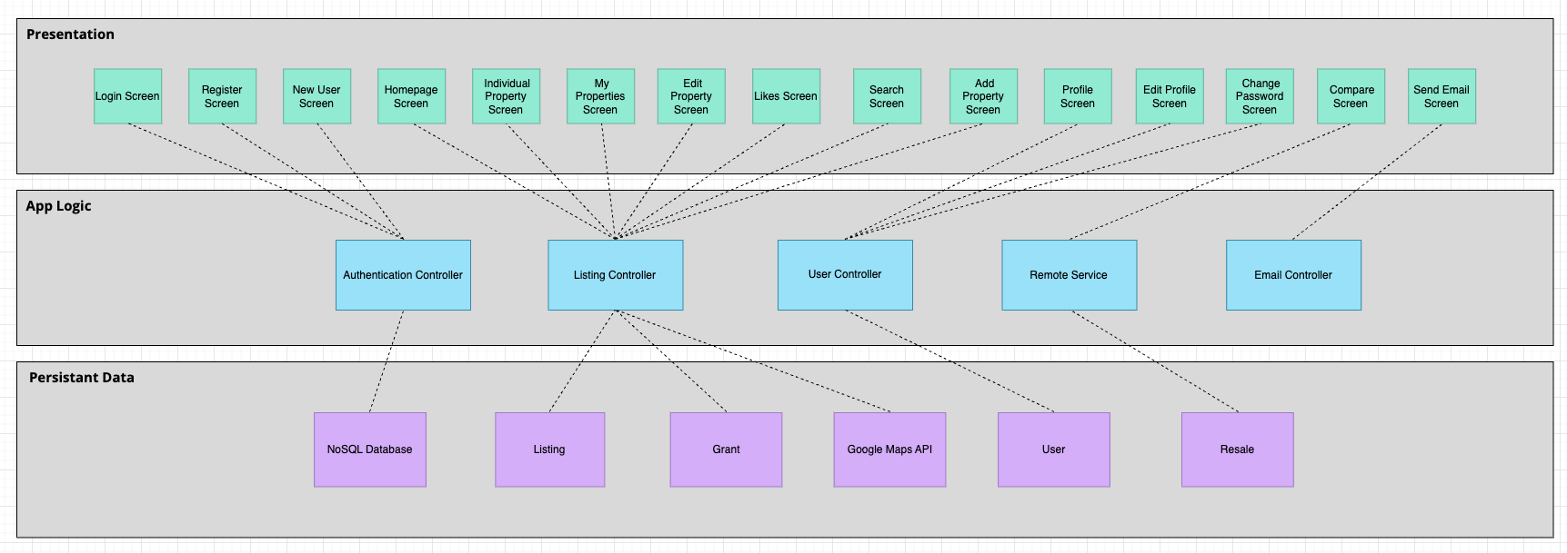
System Design
Notes:
introducing 5 main controller

Slide 9
System Design
Model-View-Controller (MVC) Architecture
Separation of the Data, View and Controller components
Encapsulate core Functionality (App Logic) + Data in Model.
If the user changes the Model/Data via the Controller of one View, all other Views dependent on this data should reflect the changes.
Notes:
for system design, we applied model-view-controller architecture by separating the data, view and controller components.
since our application use multiple synchronized presentation of shared data,
we setpearat the data, view and controllers components that allows the real-time upload of data presentation:
If the user changes the Model via the Controller of one View, all other Views dependent on this data should reflect the changes

Slide 10
03
Live Demonstration

Slide 11
Grant Calculator Logic
 | Room | Monthly Income | Age | Citizenship | Grant Awarded | Amount Awarded
Couples | <=4 | <=14000 | 22 | Singaporean | HDB_Housing_Grant | $80000
Couples | <=4 | < 9000 | 22 | Singaporean | HDB_Enhanced_Housing_Grant | $5000
Couples | 5 | <=14000 | 22 | Singaporean | HDB_Housing_Grant | $50000
Family | <=4 | <=21000 | 22 | Singaporean | HDB_Housing_Grant | $40000
Family | <=4 | < 4500 | 22 | Singaporean | HDB_Enhanced_Housing_Grant | $5000
Family | 5 | <=21000 | 22 | Singaporean | HDB_Housing_Grant | $30000
Singles | 4 | 4<=7500 | 35 | Singaporean | SINGLE_Grant | $40000
Singles | 5 | 4<=7500 | 35 | Singaporean | SINGLE_Grant | $25000
Notes:
BaaS is backend as a service

Slide 12
04
Good Software Design Principle

Slide 13
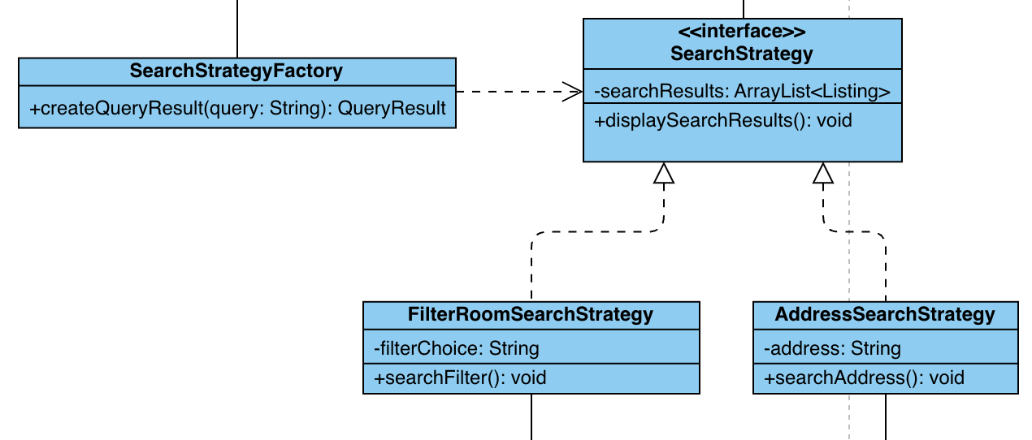
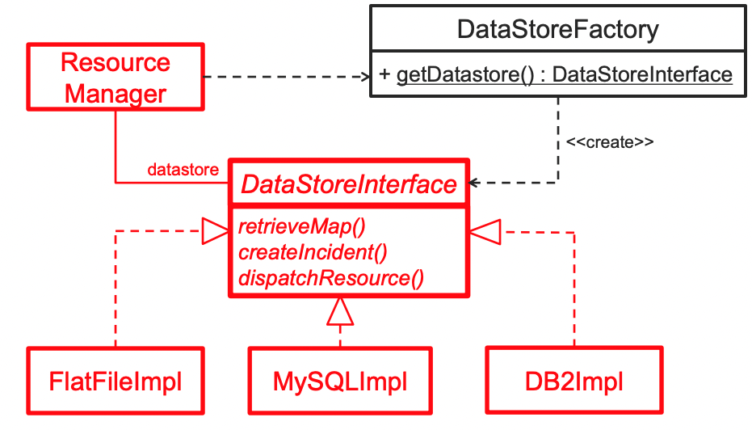
Strategy Pattern - Factory Method
Purpose
Traditionally, adding a new form of listing query would require making changes to the entire code-base
How
Factory Method pattern suggests that instead of creating objects directly (using New operator) we use a factory method that creates and object for us
Outcome
More types of search queries are expected to be added in for future app extensions (e.g Query by listing price)

Slide 14

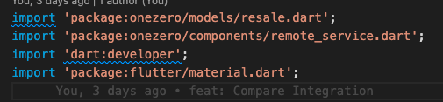
Dependency Injection Principle
Purpose
Flutter like many other modern applications rely on external libraries / packages (dependencies) to add functionality or features to the app
How
Use external packages from ‘pub.dev’ in the application by using ‘import’ statement. Their functionality can be accessed through the imported classes, methods or objects. Provide dependencies from external packages rather than having to construct it.
Outcome
Very useful for testing, since it allows dependencies to be mocked or stubbed out. Ensures the quality and reliability of application

Slide 15
Good Design for Non - Functional Requirements (Human Computer Interaction)
Clean UI and ease of use (UX).
Set Nav bar allows for easy navigation.
Usability
Software system or component can be easily modified to correct faults or bugs, which is achieved by the separation of classes (MVC framework).
Maintainability
Authentication controller and Firebase provide security for accounts of users. Validation using Regex functions.
Security

Slide 16
05
Good Traceability

Slide 17
Comprehensive Design
Sequence & Class Diagrams
Notes:
made complete and comprehensive design for better and stable implementation.
especially the sequence and class diagrams, which we use to decide the flow between different component
and so that we can decide the system design and component structure using the class diagram and other tools

Slide 18
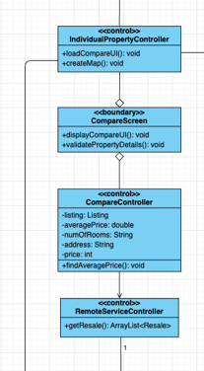
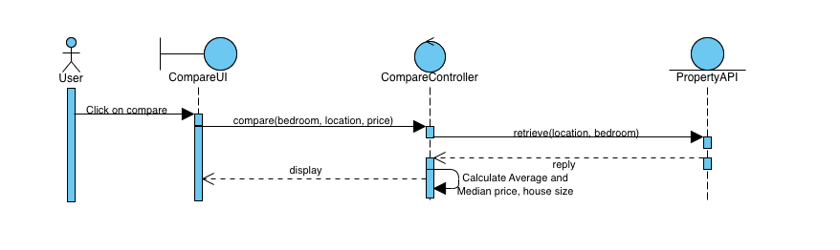
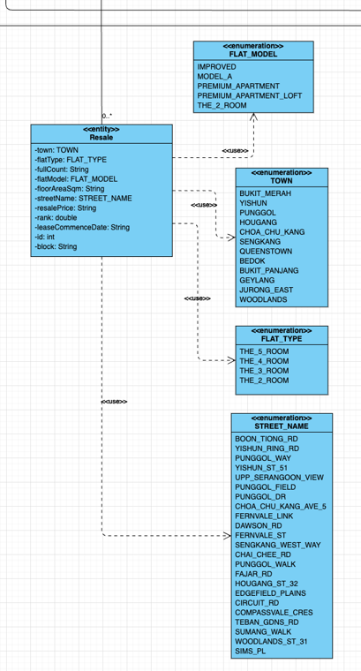
Compare
Notes:
flow:
one example is compare
after user click to compare, the UI will send the command to the controller to execute the function;
but the controller need data, so it will retrieve from the property entity to calculate and display in UI
that’s how we connect component related to compare function with property and the entities

Slide 19
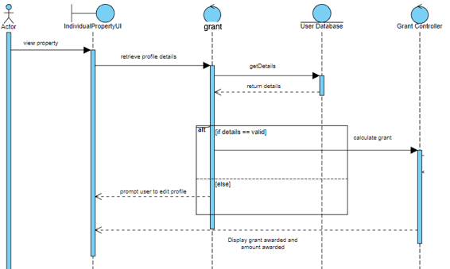
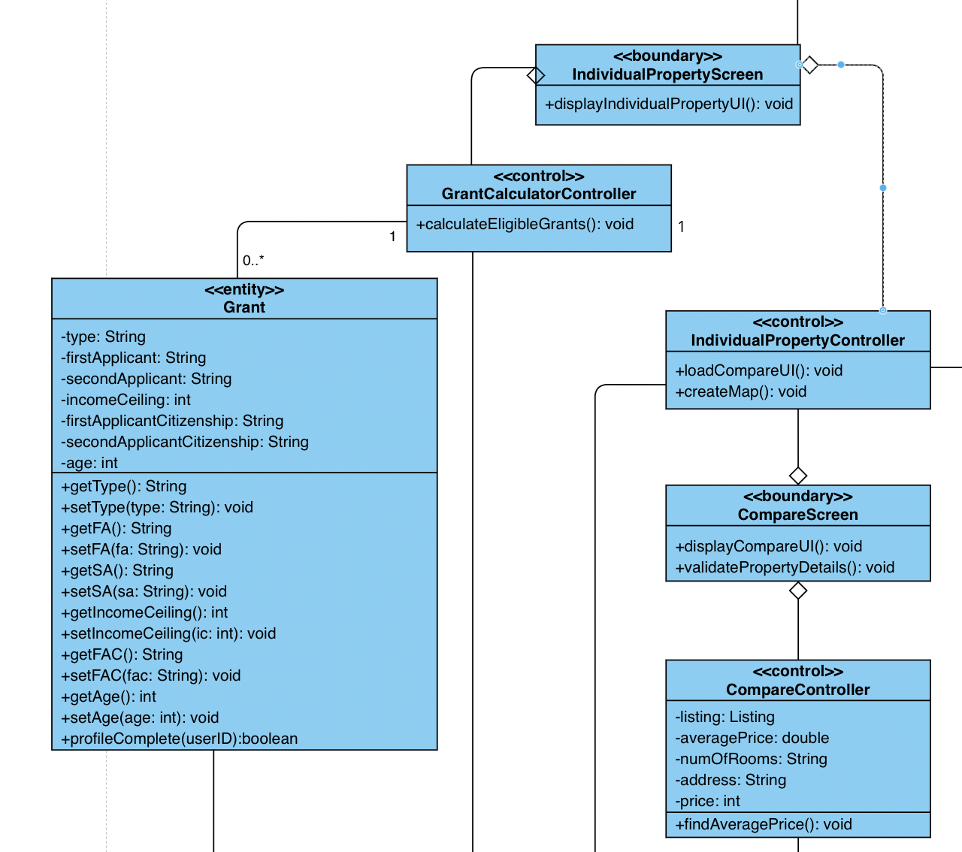
Grant Calculator
Notes:
another example is grant calculator
single responsibility principle in UML design

Slide 20
Software Design Methodology
- SCRUM for fast development
Product Backlog
SCRUM Planning & Meeting
A prioritized list of features and requirements to keep on working.
9.30pm meetings on Tuesday/Sun
Meeting minutes and documentation
Reviews & Product Refinement
1-2 Weekly sprints
Match the weekly lab schedule and submissions to check in on progress, and decide on process for next sprint
Check after each sprint for improvement
Check with use case description & requirement analysis to integrate and upgrade
Notes:
integrate and
reviews and product refinement: incremental software processes

Slide 21





Project Traceability and software Practices
Documentation
Branch & Version Control
Design

Slide 22
06
White & Black Box Testing

Slide 23
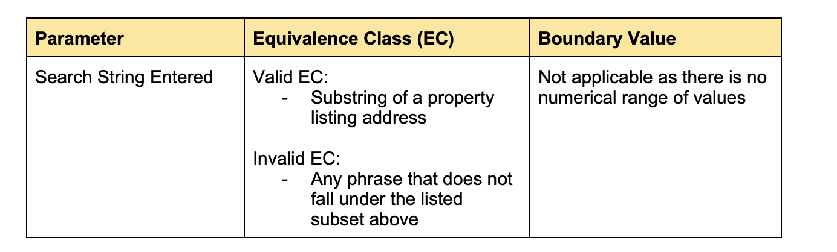
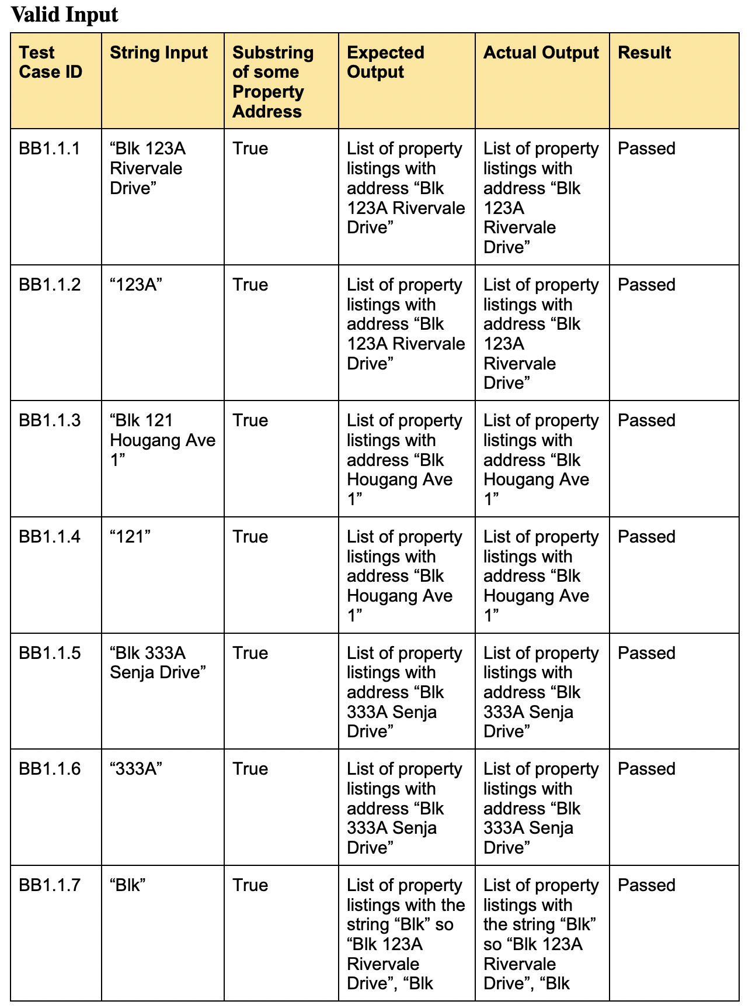
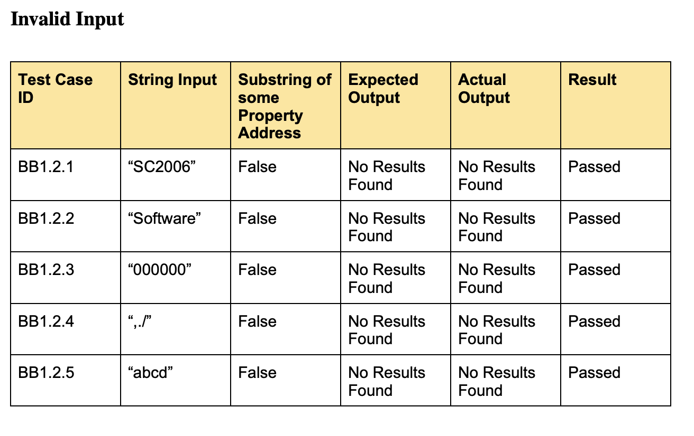
Test Cases - Search

Slide 24
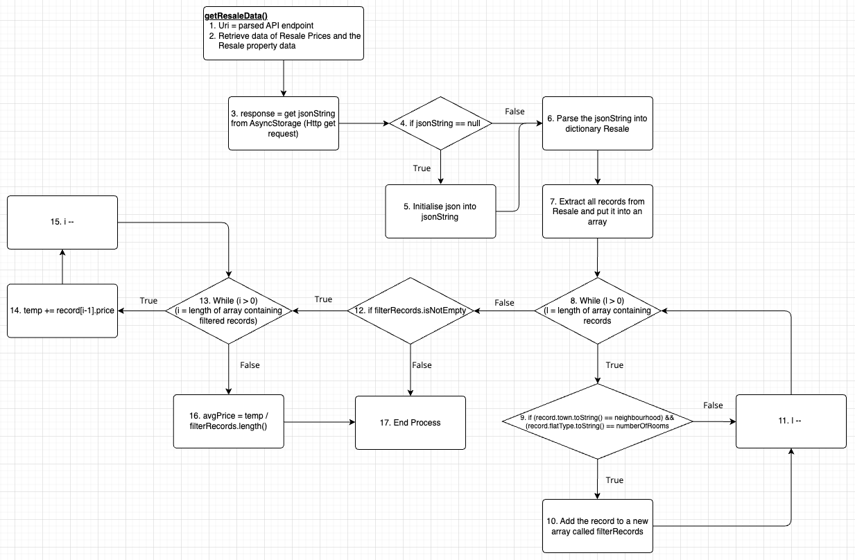
WhiteBox Testing 1 - getResaleData()

Slide 25
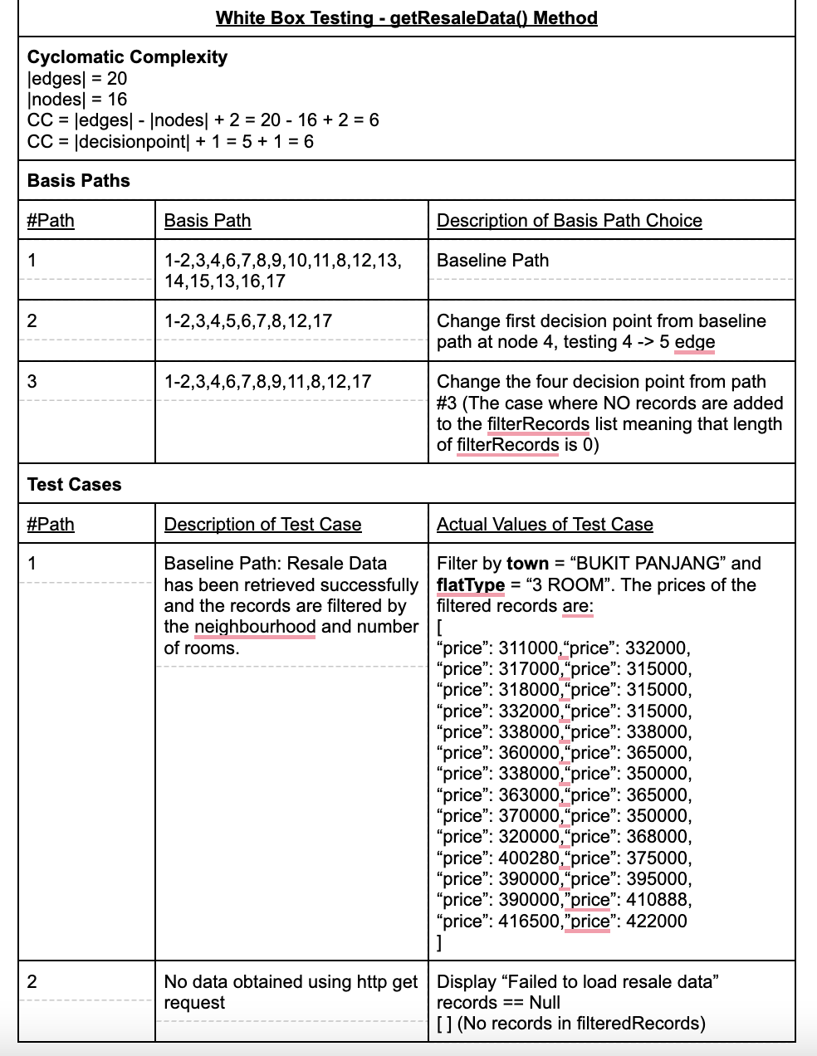
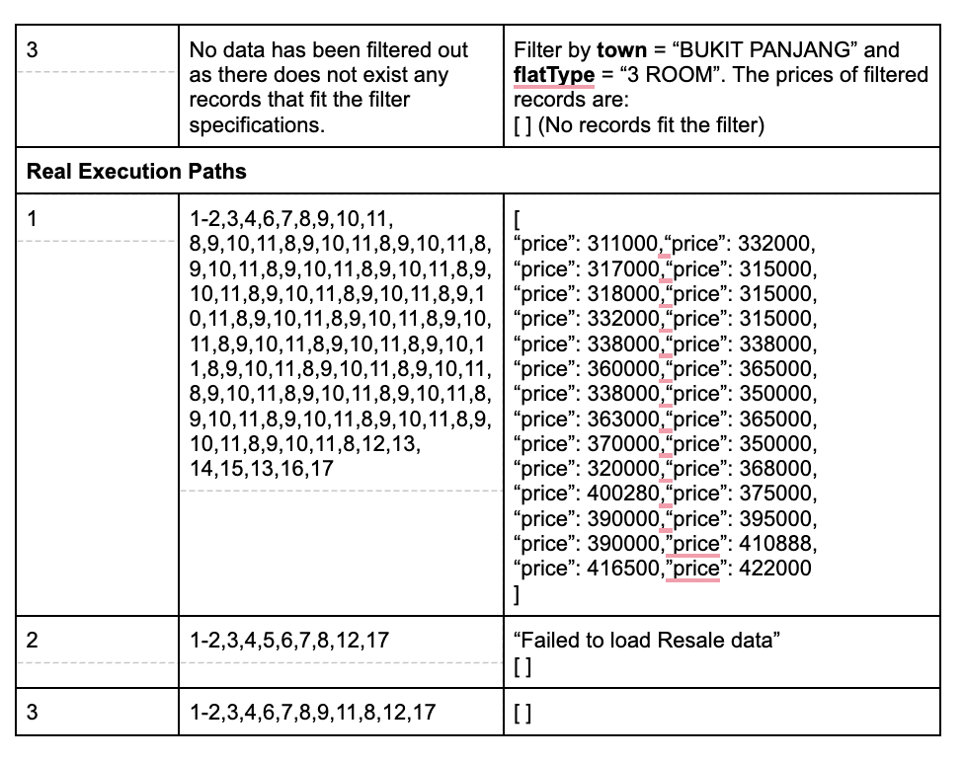
WhiteBox Testing 1 - getResaleData()

Slide 26
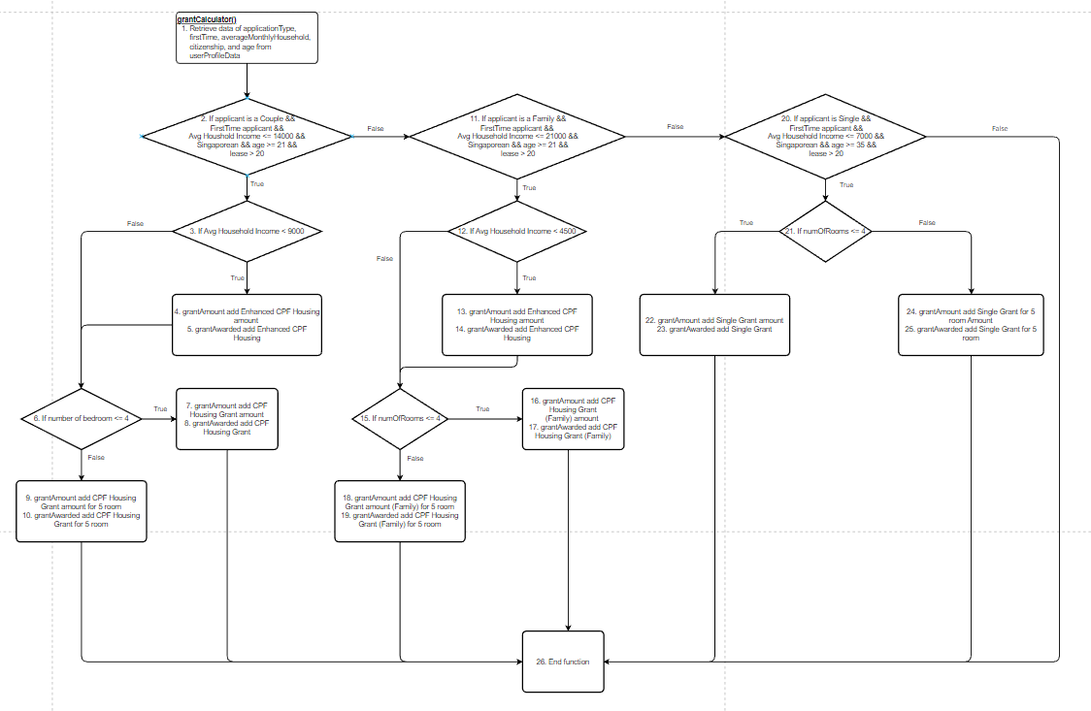
WhiteBox Testing 2 - grantCalculator()

Slide 27
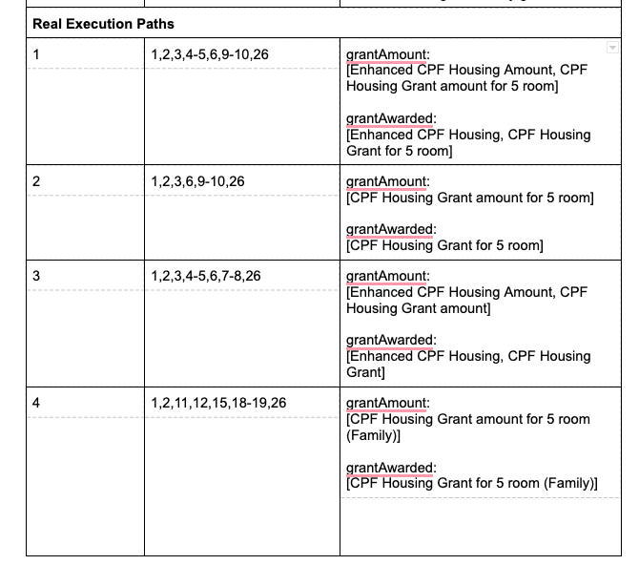
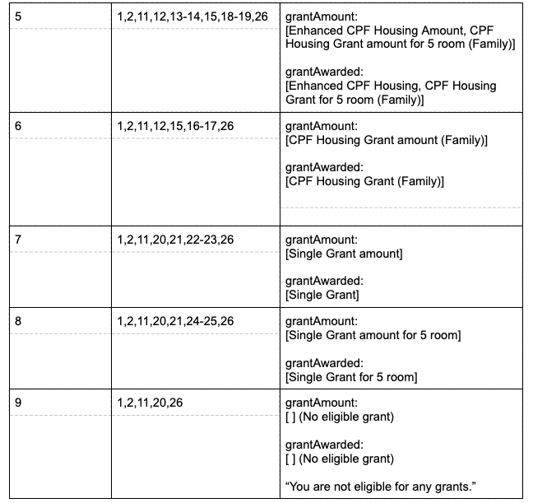
WhiteBox Testing 2 - grantCalculator()

Slide 28
Q&A
A50 Team One.Zero

